Slide 1


Linked metadata of the Science Library and the National Library

Slide 2
What: Biblioteka Nauki offers full texts of scientific articles and selected books published in Polish journals.
Scope: Covers five major subject databases (AGRO, BazTech, CEJSH, DML-PL, PS

Slide 3
Objective
To enhance the value and usability of Biblioteka Nauki by comparing and matching its records with those of the National Library.

Slide 4
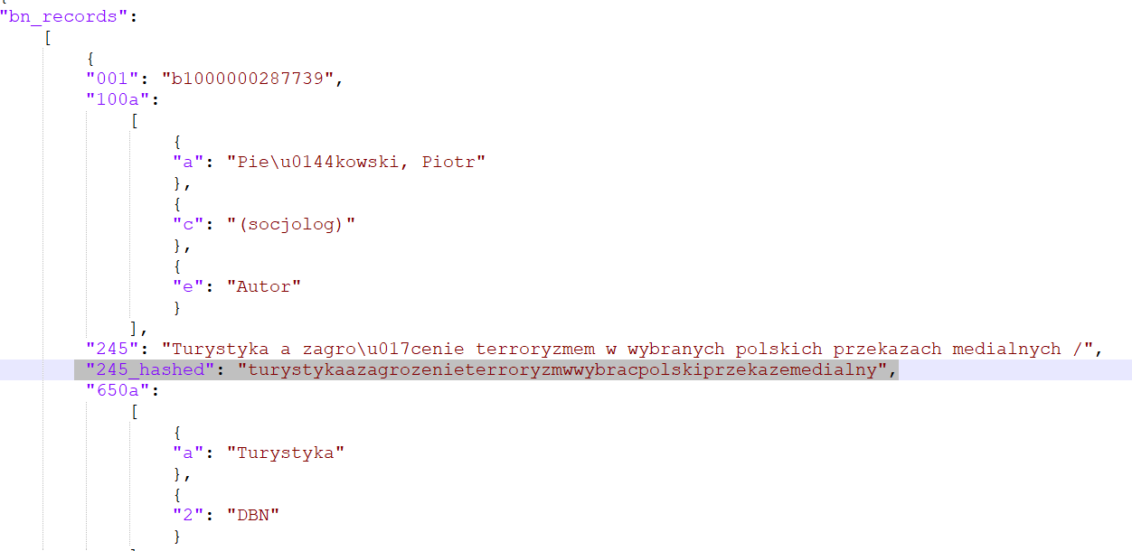
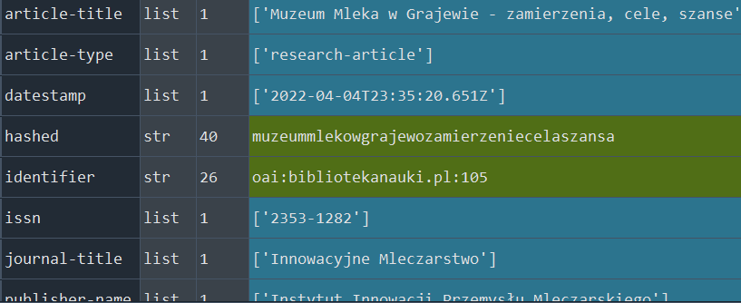
Methodology
Lemmatized titles using the spacy tool and pl_core_news_lg model.
Removed Polish characters, special characters, uppercase letters, and spaces.
Compared strings using the Levenshtein algorithm.
Set a threshold of 0.86 ratio for matches.

Slide 5
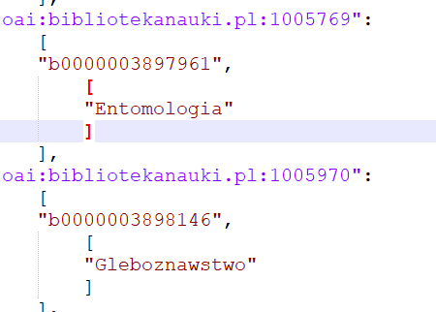
Results
Matched 119,656 bibliographic records in two json files (which you can find on GitHub).
Generated subject headings for Biblioteka Nauki using the National Library's data.
ID Biblioteka Narodowa
ID Biblioteka Nauki

Slide 6
Benefits
Comprehensive Database:
Users can now cross-reference data across multiple domains.
Greater depth of information with subject headings.
ID Biblioteka Nauki
ID Biblioteka Narodowa

Slide 7
Why It Matters
Easier and more effective for researchers to find relevant information.
Encourages academic growth and quality research in Poland.

Slide 8
Conclusion
Our work could significantly enrich the user experience of Biblioteka Nauki
Paves the way for more integrated, searchable, and valuable research databases in the future

